Slide 1
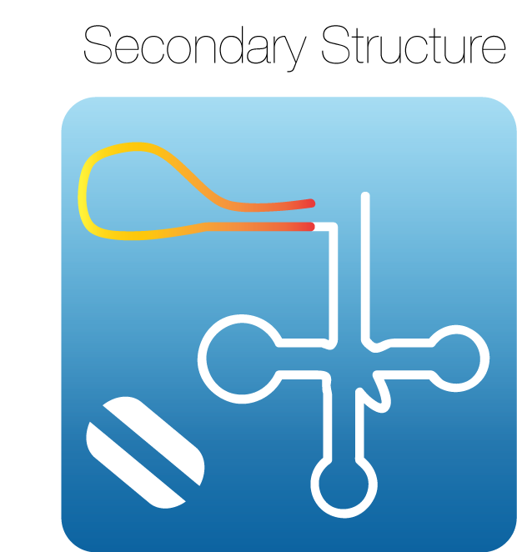

21A population
LINKER
Secondary structure
GGGAGACCGGAAUUCAGAUUG
---
AUG—AANNNNNN---
21B population
CCCUCUGGCCUUAAGUCUAAC
---
AUG—AANNNNNN---
Stem loop
21C population
GCAUGCACGAAAGUACGUGCU
---
AUG—AANNNNNN---
Notes:
We designed three different ptRNA substrates in which different 21 nucleotides extensions are appended upstream of the RNase P leader binding site located at positions N(-1) to N(-8) relative to the RNase P cleavage site. The sequence of 21A was designed to have transversion mutations (each base changed to its pairing partner) at all 21 nucleotides compared to the 21B leader extension. The 21C substrate was designed to form a stable stem loop that excludes the RNase P binding site and should insulate it from inhibitory interactions with additional leader sequences. To determine whether these different contexts influence RNase P processing specificity we are performed HTS-KIN on populations randomized at either N(-1) to N(-6) and N(-3) to N(-8) in the 21A, 21B and 21C backgrounds.

